Slide 1
Machine Learning
AIML CZG565
M6 : Instance Based Learning
Course Faculty of M.Tech Cluster
BITS – CSIS - WILP

Slide 2

Machine Learning
Disclaimer and Acknowledgement
These content of modules & context under topics are planned by the course owner Dr. Sugata, with grateful acknowledgement to many others who made their course materials freely available online
We here by acknowledge all the contributors for their material and inputs.
We have provided source information wherever necessary
Students are requested to refer to the textbook w.r.t detailed content of the presentation deck shared over canvas
We have reduced the slides from canvas and modified the content flow to suit the requirements of the course and for ease of class presentation
Slide Source / Preparation / Review:
From BITS Pilani WILP: Prof.Sugata, Prof.Chetana, , Prof.Monali, Prof.Rajavadhana, Prof.Seetha, Prof.Anita
External: CS109 and CS229 Stanford lecture notes, Dr.Andrew NG and many others who made their course materials freely available online

Slide 3
Course Plan
M1 | Introduction
M2 | Machine learning Workflow
M3 | Linear Models for Regression
M4 | Linear Models for Classification
M5 | Decision Tree
M6 | Instance Based Learning
M7 | Support Vector Machine
M8 | Bayesian Learning
M9 | Ensemble Learning
M10 | Unsupervised Learning
M11 | Machine Learning Model Evaluation/Comparison

Slide 4
Problem Type – 2
Based on the information given in the table below, find the customer type of x_{q}=C4 using K-NN. In given example consider all the instances and use locally weighted K-NN algorithm with kernel K(d(x_{q},x_{i})) = 1/ d(x_{q},x_{i})².
Apply min-max normalization on income to obtain [0,1] range. Consider profession and Region as nominal. Consider :Locality as ordinal variable with ranking order of [Village, Small Town, Suburban, Metropolitan]. Give equal weight to each attribute.
Customer | Income | Profession | Region | Locality | Category
C0 | 60000 | Doctor | Hindi | Village | L1
C1 | 70000 | Doctor | Bengali | Village | L2
C2 | 60000 | Carpenter | Hindi | Suburban | L2
C3 | 80000 | Doctor | Bhojpuri | Metropolitan | L2
C5 | 80000 | Data Scientist | Hindi | Small Town | L1
C4 | 50000 | Data Scientist | Hindi | Small Town

Slide 5
Problem Type – 2
Based on the information given in the table below, find the customer type of x_{q}=C4 using K-NN. In given example consider all the instances and use locally weighted K-NN algorithm with kernel K(d(x_{q},x_{i})) = 1/ d(x_{q},x_{i})².
Apply min-max normalization on income to obtain [0,1] range. Consider profession and Region as nominal. Consider :Locality as ordinal variable with ranking order of [Village, Small Town, Suburban, Metropolitan]. Give equal weight to each attribute.
Customer | Income | Profession | Region | Scaled Locality | Category
C0 | 0.33 | Doctor | Hindi | 1 🡪 0 | L1
C1 | 0.67 | Doctor | Bengali | 1 🡪 0 | L2
C2 | 0.33 | Carpenter | Hindi | 3 🡪 0.67 | L2
C3 | 1 | Doctor | Bhojpuri | 4 🡪 1 | L2
C5 | 1 | Data Scientist | Hindi | 2 🡪 0.33 | L1
C4 | 0 | Data Scientist | Hindi | 2 🡪 0.33
Distance | Weight
0.97 | 1.06
1.75 | 0.33
0.97 | 1.06
2.2 | 0.21
1 | 1
0 (NA)
d(C4, C2)
= distance w.r.t to numerical attributes + distance w.r.t Nominal attributes
= Euclidean distance on (Income, Scaled Locality ) + Categorical distance on attributes (Profession, Region)
= √((Income_{c4-}Income_{c2)}^{"2}" +( Locality_{c4-}Locaility_{c2)}² )+(No.of.Categorical features -No.of.Matches between C4 & C2)/(No.of.Categorical Features)
= √((0-0.33)^{"2}" +( 0.33-0.67)² )+(2 -1)/2
= 0.47 + 0.5 = 0.97

Slide 6
Problem Type – 2
Based on the information given in the table below, find the customer type of x_{q}=C4 using K-NN. In given example consider all the instances and use locally weighted K-NN algorithm with kernel K(d(x_{q},x_{i})) = 1/ d(x_{q},x_{i})².
Apply min-max normalization on income to obtain [0,1] range. Consider profession and Region as nominal. Consider :Locality as ordinal variable with ranking order of [Village, Small Town, Suburban, Metropolitan]. Give equal weight to each attribute.
Customer | Income | Profession | Region | Scaled Locality | Category
C0 | 0.33 | Doctor | Hindi | 1 🡪 0 | L1
C1 | 0.67 | Doctor | Bengali | 1 🡪 0 | L2
C2 | 0.33 | Carpenter | Hindi | 3 🡪 0.67 | L2
C3 | 1 | Doctor | Bhojpuri | 4 🡪 1 | L2
C5 | 1 | Data Scientist | Hindi | 2 🡪 0.33 | L1
C4 | 0 | Data Scientist | Hindi | 2 🡪 0.33
Distance | Weight
0.97 | 1.06
1.75 | 0.33
0.97 | 1.06
2.2 | 0.21
1 | 1
0 (NA)
Point | Kernel / Weight | Class
C5 | 1 | L1
C0 | 1.06 | L1
C2 | 1.06 | L2
C1 | 0.33 | L2
C3 | 0.21 | L2
Inference : Without weighted KNN, L2 is the majority voted class.
But with weighted distances, L1 class instances are more similar to C4

Slide 7
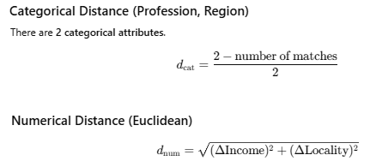
Problem Type – 2
(a) Min–Max normalization of Income
Income range: min = 50000, max = 80000
Income (norm) = (Income – 50000) / 80000
(b) Ordinal encoding for Locality:
Ranking:Village < Small Town < Suburban < Metropolitan
Encoded as:Village = 0, Small Town = 1, Suburban = 2, Metropolitan = 3
To keep equal importance, normalize by max rank (3):
Customer | Income | Normalized
C0 | 60000 | 0.333
C1 | 70000 | 0.667
C2 | 60000 | 0.333
C3 | 80000 | 1.000
C5 | 80000 | 1.000
C4 (xq) | 50000 | 0.000
Locality | Normalized
Village | 0.000
Small Town | 0.333
Suburban | 0.667
Metropolitan | 1.000
Query point C4: 50000, Data Scientist, Hindi, Small Town

Slide 8
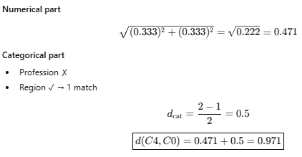
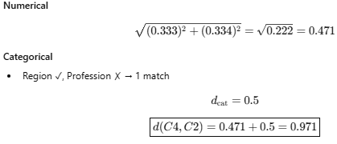
Problem Type – 2
Distance computation
Final Distance Table:
C4 and C0:
Customer | Numerical | Categorical | Total Distance | Category
C0 | 0.471 | 0.5 | 0.971 | L1
C1 | 0.745 | 1.0 | 1.745 | L2
C2 | 0.471 | 0.5 | 0.971 | L2
C3 | 1.202 | 1.0 | 2.202 | L2
C5 | 1.000 | 0.0 | 1.000 | L1
Majority Vote (Unweighted KNN)
Count class labels:
L1 → C0, C5 → 2
L2 → C1, C2, C3 → 3
C4 and C2:
Final Prediction (Normal KNN)
Class of C4=L2

Slide 9
Problem Type – 2
Final Distance Table (unweighted KNN):
Final Distance Table (weighted KNN):
Customer | Numerical | Categorical | Total Distance | Category
C0 | 0.471 | 0.5 | 0.971 | L1
C1 | 0.745 | 1.0 | 1.745 | L2
C2 | 0.471 | 0.5 | 0.971 | L2
C3 | 1.202 | 1.0 | 2.202 | L2
C5 | 1.000 | 0.0 | 1.000 | L1
Customer | Numerical | Categorical | Total Distance | Weight | Category
C0 | 0.471 | 0.5 | 0.971 | 1.06 | L1
C1 | 0.745 | 1.0 | 1.745 | 0.33 | L2
C2 | 0.471 | 0.5 | 0.971 | 1.06 | L2
C3 | 1.202 | 1.0 | 2.202 | 0.21 | L2
C5 | 1.000 | 0.0 | 1.000 | 1 | L1
Majority Vote (Unweighted KNN)
Count class labels:
L1 → C0, C5 → 2
L2 → C1, C2, C3 → 3
Class-wise Weight Sum
Class L1
C0: 1.060
C5: 1.000
Total (L1) = 2.060
Class L2
C1: 0.328
C2: 1.060
C3: 0.206
Total (L2) = 1.594
Final Prediction (Normal KNN)
Class of C4=L2
Final Prediction (Weighted K-NN)
Class of C4=L1

Slide 10
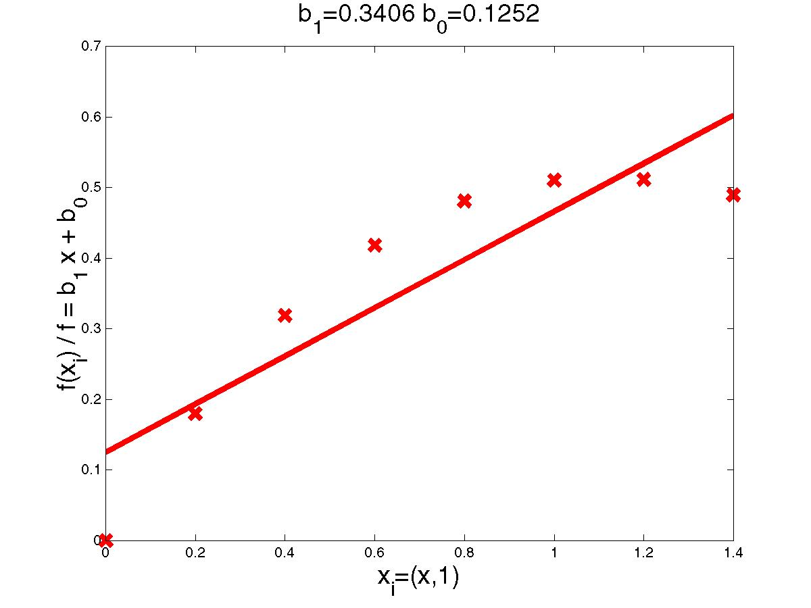
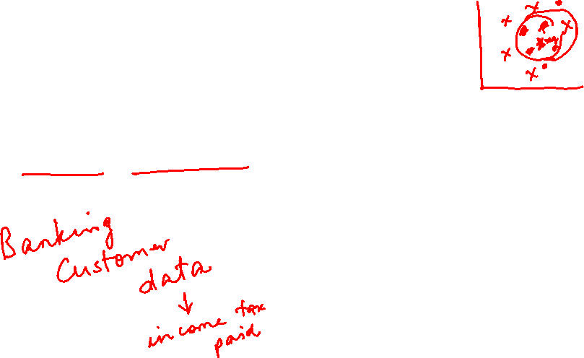
Locally Weighted Regression

Slide 11
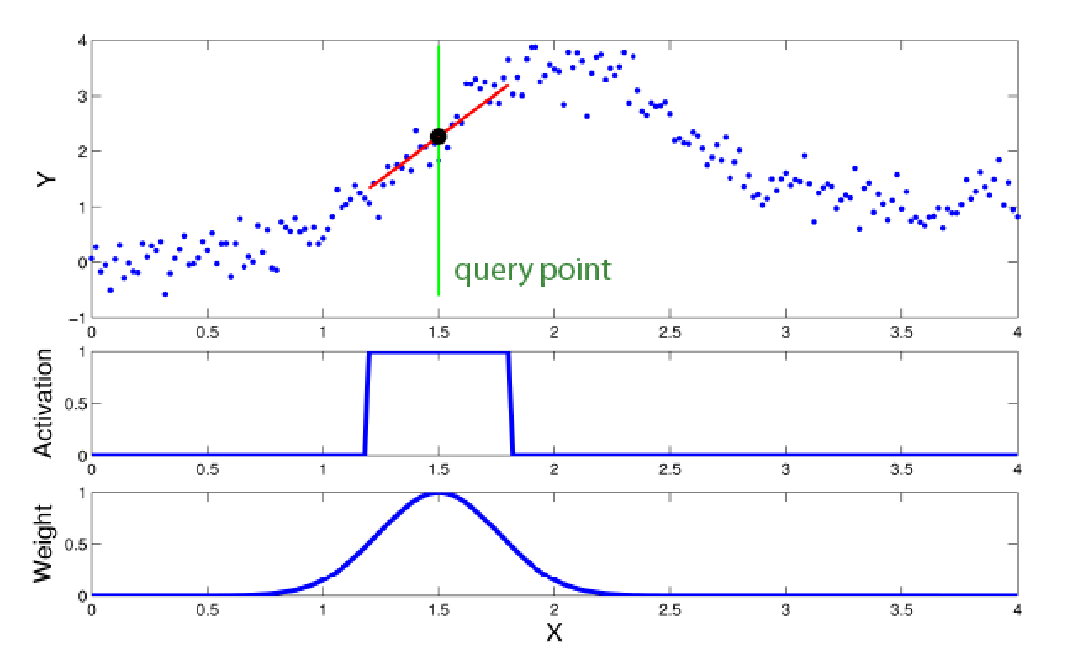

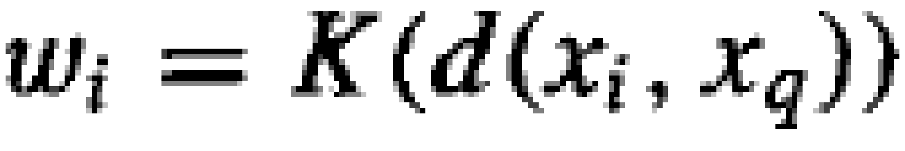
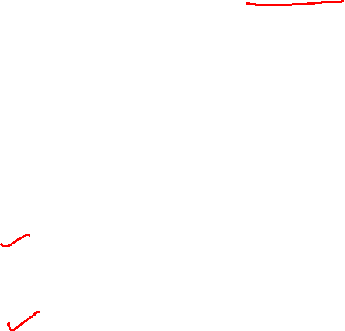
Locally Weighted Regression
Locally – Function approximated based on data near query point
Weighted – Contribution by each training example is weighted by its distance from query point
Regression- Approximates real-valued target function
Residual is the error in approximating the target function.
Kernel function is the function of distance that is used to determine the weight of each training example. In other words, the kernel function is the function K such that
Source Credit : https://www.ias.informatik.tu-darmstadt.de/uploads/Teaching/AutonomousLearningSystems/Englert_ALS_2012.pdf

Slide 12
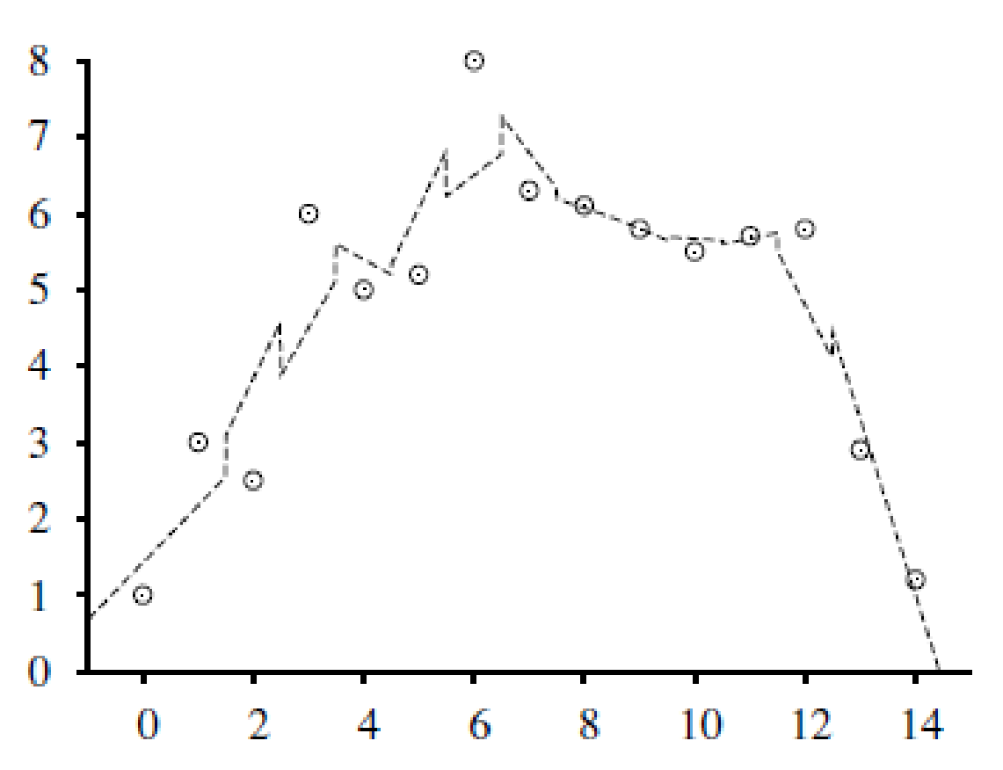
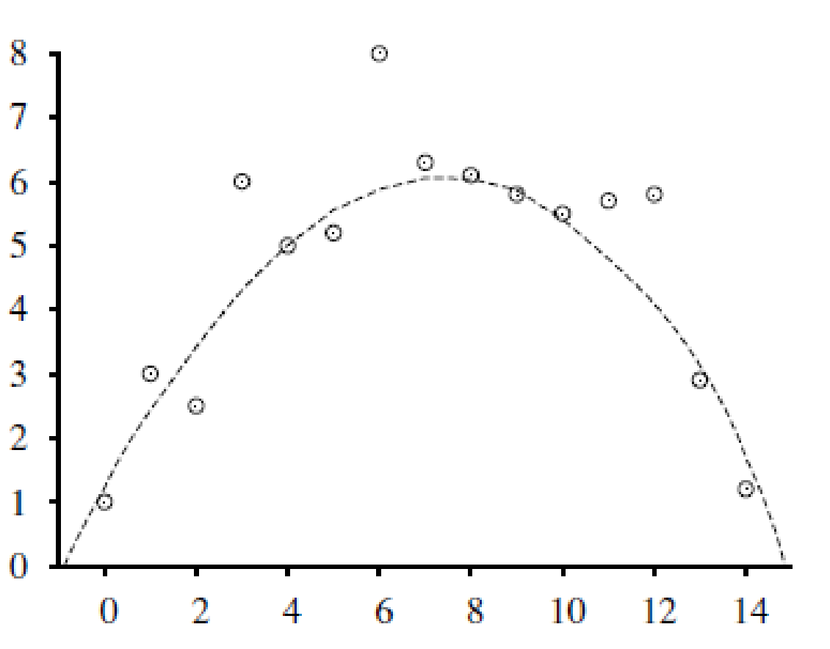
Locally Weighted Regression
3-nearest-neighbors linear regression
The nearest-neighbor approaches can be thought of as approximating the target function f (x) at the single query point x = x_{q}
Locally weighted regression is a generalization of this approach. It constructs an explicit approximation to f over a local region surrounding x_{q}
Approximate the target function in the neighborhood surrounding x, using a linear function, a quadratic function, a multilayer neural network, or some other functional form.
Locally weighted regression with
a quadratic kernel

Slide 13
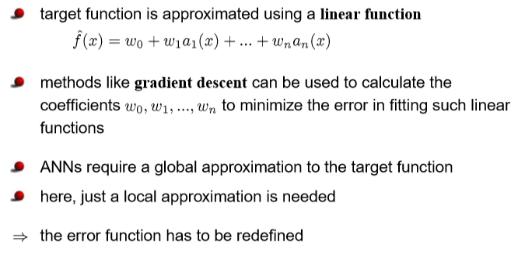

Locally weighted linear regression

Slide 14
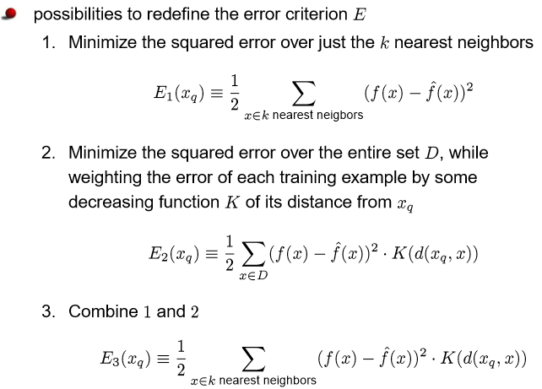
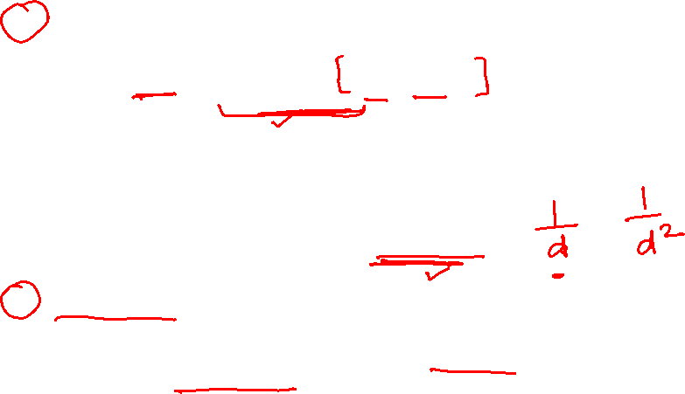
Locally weighted linear regression

Slide 15
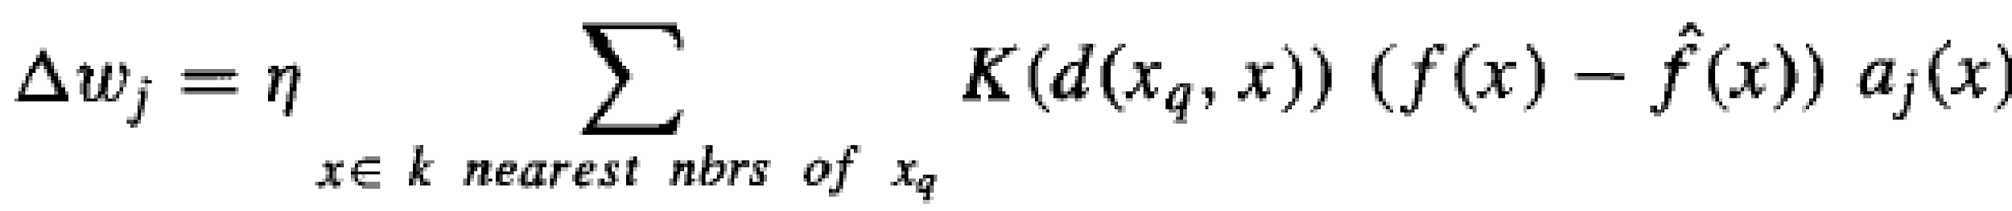
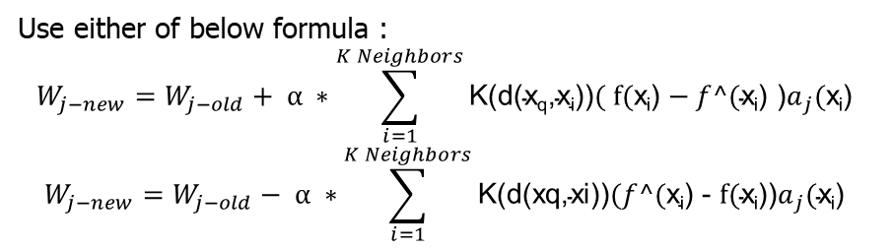
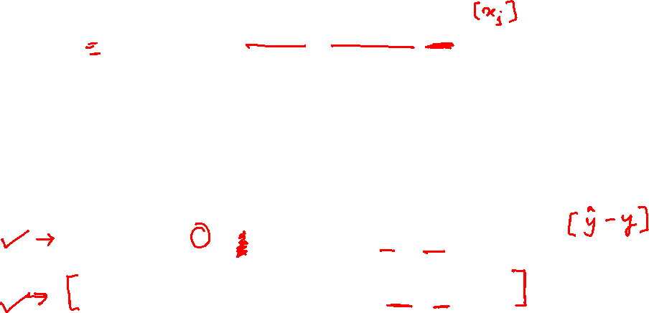
Locally weighted linear regression
For a given query point x_{q} we solve the following weighted regression problem using gradient descent training rule:
Note that we need to solve a new regression problem for every query point—that’s what it means to be local.
In ordinary linear regression, we solved the regression problem once, globally, and then used the same h_{w} for any query point.

Slide 16
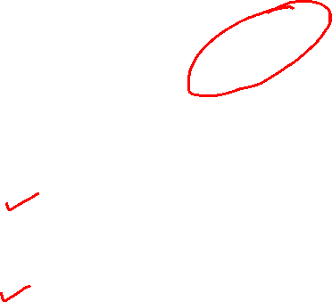
Example
The upper graphic the set of data points (x,y) (blue dots), query point (green line), local linear model (red line) and prediction (black dot).
The graphic in the middle shows the activation area of the model.
The corresponding weighting kernel (receptive field) is shown in the bottom graphic.
Source Credit : https://www.ias.informatik.tu-darmstadt.de/uploads/Teaching/AutonomousLearningSystems/Englert_ALS_2012.pdf

Slide 17
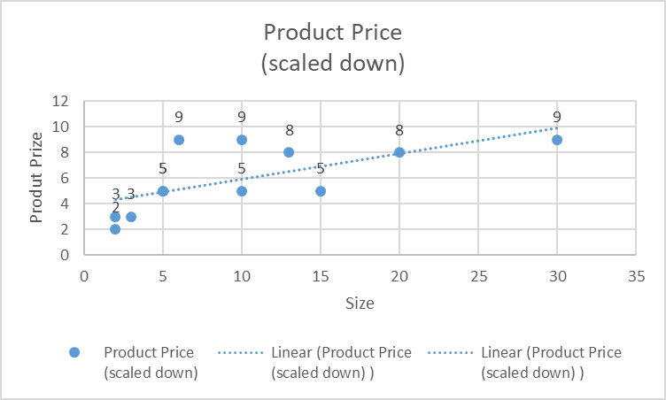
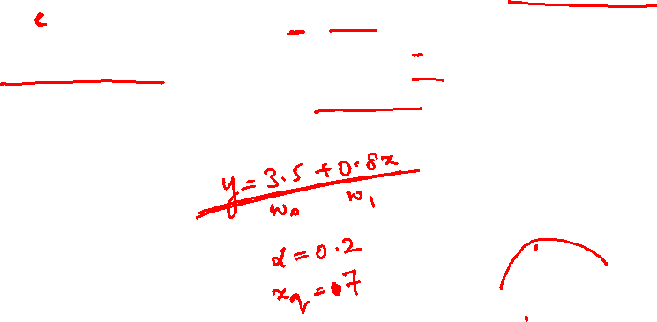
Problem Type - 3
Consider the following training set in 2-dimensional Euclidean space. What is the prize of the product with size 7 if 5-NN is considered? Use the kernel of the form K(d(x_{q},x_{i})) = exp( - d(x_{q},x_{i})² / 2b²) where b=1. Use the linear regression of the form y = 3.5 + 0.8 x and the learning rate of 0.2 to apply the gradient descent and update the weights at the end of first iteration
Size | Product Price (scaled down)
10 | 5
5 | 5
2 | 2
3 | 3
5 | 5
15 | 5
30 | 9
20 | 8
6 | 9
2 | 3
10 | 9
13 | 8

Slide 18
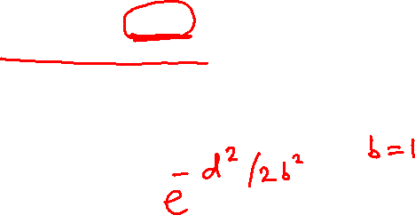
Problem Type - 3
Consider the following training set in 2-dimensional Euclidean space. What is the prize of the product with size 7 if 5-NN is considered? Use the kernel of the form K(d(x_{q},x_{i})) = exp( - d(x_{q},x_{i})² / 2b²) where b=1. Use the linear regression of the form y = 3.5 + 0.8 x and the learning rate of 0.2 to apply the gradient descent and update the weights at the end of first iteration
Size | Product Price (scaled down)
10 | 5
5 | 5
2 | 2
3 | 3
5 | 5
15 | 5
30 | 9
20 | 8
6 | 9
2 | 3
10 | 9
13 | 8

Slide 19
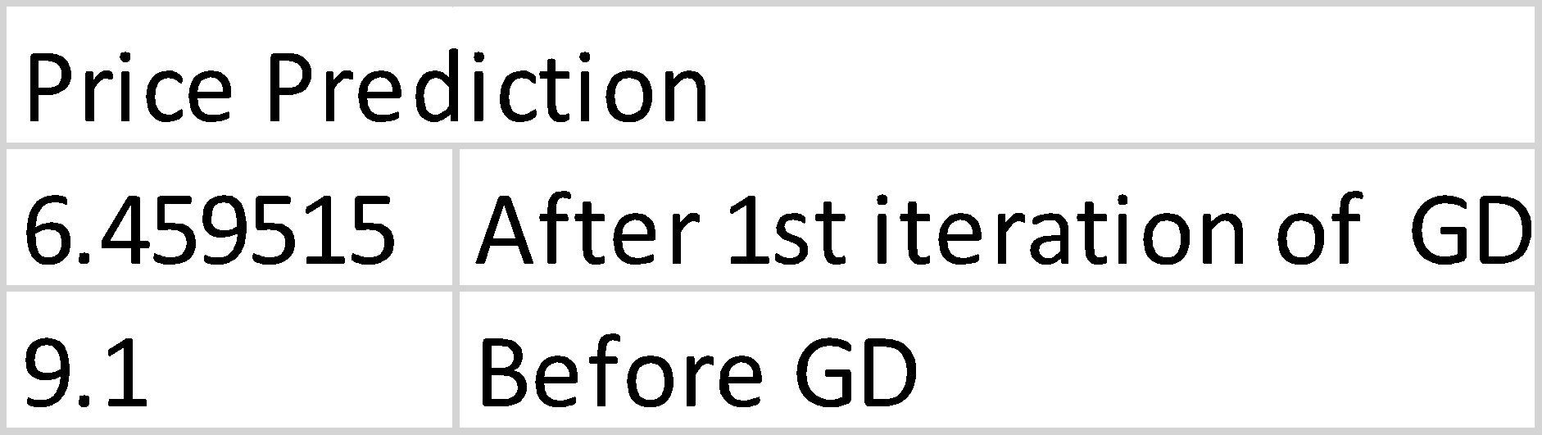
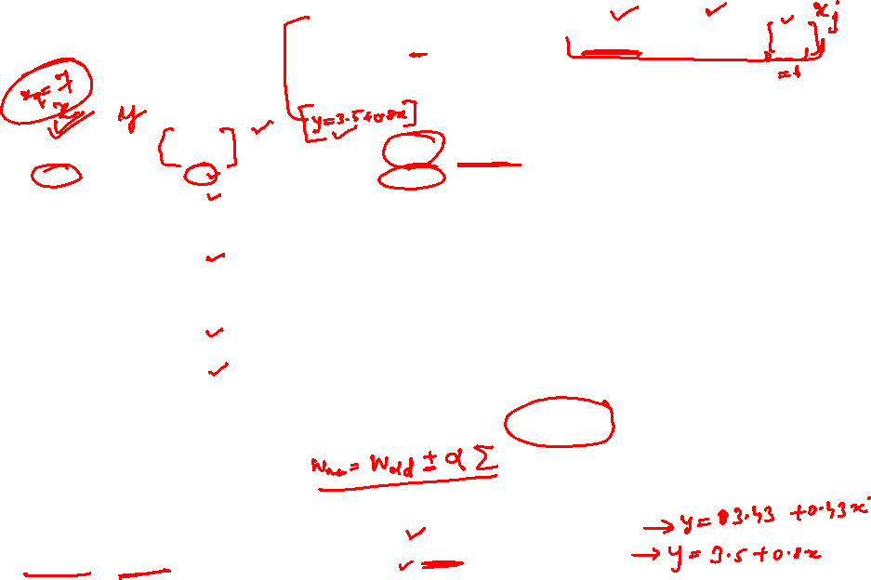
Problem Type - 3
Size | Product Price (Y) | d(xq, xi) | K(d(x_{q},x_{i})) | Y’ | Y-Y’ | (Y-Y’) * a | K * (Y-Y’) * a | LR * Gradient | W_{old} + delta
10 | 5 | 3 | 0.01 | 11.5 | -6.5 | -65 | -0.65
5 | 5 | 2 | 0.14 | 7.5 | -2.5 | -12.5 | -1.75
2 | 2 | 5 | 0
3 | 3 | 4 | 0
5 | 5 | 2 | 0.14 | 7.5 | -2.5 | -12.5 | -1.75
15 | 5 | 8 | 0
30 | 9 | 23 | 0
20 | 8 | 13 | 0
6 | 9 | 1 | 0.61 | 8.3 | 0.7 | 4.2 | 2.6
2 | 3 | 5 | 0
10 | 9 | 3 | 0.01 | 11.5 | -2.5 | -25 | -0.25
13 | 8 | 6 | 0
 |  |  |  |  |  |  | Sum = -1.8 | LR * sum = -0.36 | New weight = 0.44
Apply gradient descent where the gradient is weighed by the kernel output.
Answer :
Updated weights after 1st iteration
w0 = 3.43, w1= 0.43

Slide 20

When to Consider Nearest Neighbors
Suitable for Low dimensional datasets
Local information can yield highly adaptive behavior
Lots of training data (distance-weighted KNN)
    Training is very fast
  Learn complex target functions
    Do not lose information
  Noisy training data (distance-weighted KNN)
  by taking the weighted average of the k neighbors nearest to the query point, it can smooth out the impact of isolated noisy training examples.

Slide 21

Nearest-Neighbor Classifiers: Challenges
The value of k, the number of nearest neighbors to retrieve
Choice of Distance Metric to compute distance between records
Expensive, Slow at query time
  To determine the nearest neighbour of a query point q, must compute the distance to all N training examples
    Pre-sort training examples into fast data structures (kd-trees)
    Remove redundant data (condensing)
Storage Requirements
  Must store all training data P
    Remove redundant data (condensing)

Slide 22
Additional Exercise for Students
Consider the following training set in 2-dimensional Euclidean space. What is the prize of the product with size 12 if 7-NN is considered? Use the kernel of the form K(d(x_{q},x_{i})) = 1/ d(x_{q},x_{i})². Use the linear regression of the form y = 2 + 1.5 x and the learning rate of 0.6 to apply the gradient descent and update the weights at the end of first iteration. Use Manhattan Distance for the distance calculation.
Try to scale all the features with min-max of [0-5] and redo the modelling under previous question. Observe to Interpret the influence of the scaling
Find the MSE of the K-NNs from the results of both above parts separately & state your observations
If the Product with features (13,6) and (30,4) are outliers then interpret the effect of the same in the K-NN modelling, before and after removing them with numerical justication.
Size | Rating (1-10) | Product Price (scaled down)
10 | 5 | 5
5 | 2 | 5
2 | 7 | 2
3 | 6 | 3
5 | 4 | 5
15 | 8 | 5
30 | 4 | 9
20 | 8 | 8
6 | 10 | 9
2 | 2 | 3
10 | 4 | 9
13 | 6 | 8

Slide 23
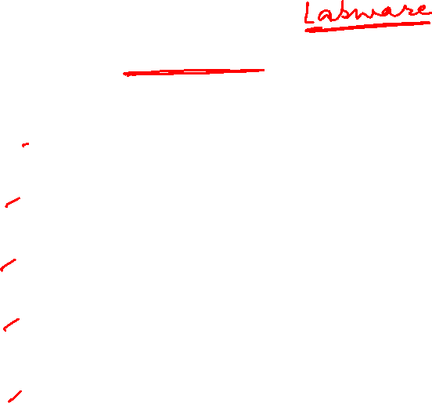
Lab : Practise :
Take any BITS virtual Lab dataset and experiment on below cases
Tune KNN. Try different values of k to see if you can improve the performance of the algorithm.
Use weighted KNN and check the performance
Regression. Apply it to a regression predictive modelling problem (e.g. predict a numerical value)
More Distance Measures. Implement other distance measures such as Hamming distance, Manhattan distance and Minkowski distance.
Data Preparation. Distance measures are strongly affected by the scale of the input data. Experiment with and without standardization and other data preparation methods in order to improve results.

Slide 24
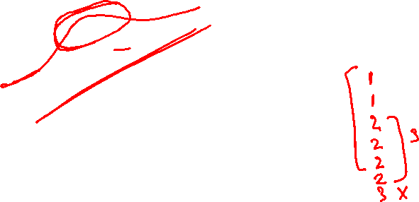
Thank you !
Required Reading for completed session :
T1 - Chapter # 8 (Tom M. Mitchell, Machine Learning)
Next Session Plan :
Module 7 : Support vector machines will be covered in CS 15 or 16
Important Note for SVM : Below Math Pre-requisite (Yet to be discussed in MFML parallel course) :
Since the math basics will be covered in detail in math course, ML course is intended to discuss the application & interpretation of the model
Lagrange Multipliers
KKT – Conditions
Primal – Dual for SVM
Kernel for Non-Linear SVM

